Slide 1
Toronto Bikeshare
Presented to you by The Dilligent Debuggers
December 05, 2022

Slide 2
Who are the
Diligent Debuggers ?!
Bruce (Haoyu) Li
Fiyad Hussein
Mennatallah Alnahas
Zhijie Nie

Slide 3
TABLE OF CONTENTS
Introduction
Dataset Description
01
02
Datasets Cleaning
Exploratory Data Analysis
03
04
Temporal
Exploratory Data Analysis
Model Development
05
06
GeoSpatial

Slide 4
OUR GOALS
Data Exploration
Ad Campaign
New App Feature
Recognize the temporal and geospatial patterns of bike rides
Answer the questions of When and Where?
Propose an intermediate docking station if ride duration > 45 mins

Slide 5
Dataset Cleaning

Slide 6
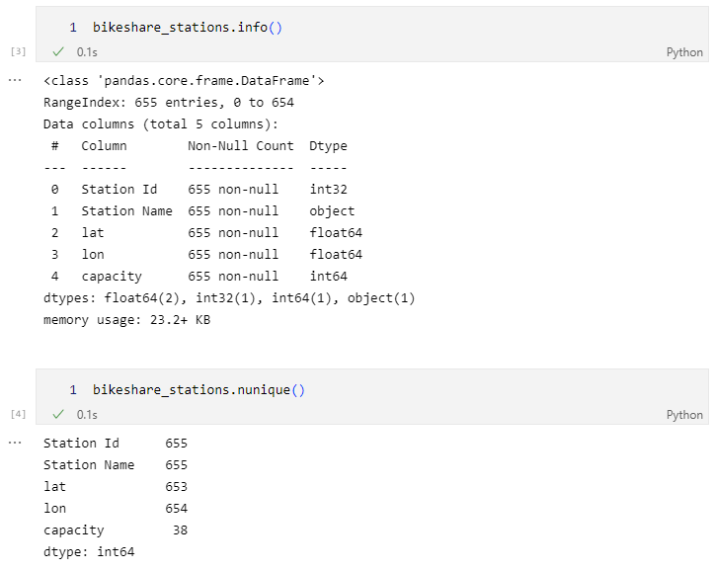
Data Cleaning-Bikeshare Stations Data
Get
Retrieve the up-to-date bikeshare station information from `https://tor.publicbikesystem.net`.
Rename
Rename the columns
Clean
Check for missing values and duplicates
Output
Write bikeshare station dataframe to a csv file
Clean station data:
“bikeshare_stations”

Slide 7
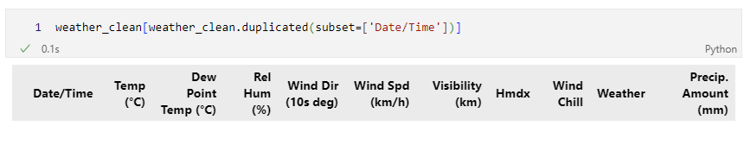
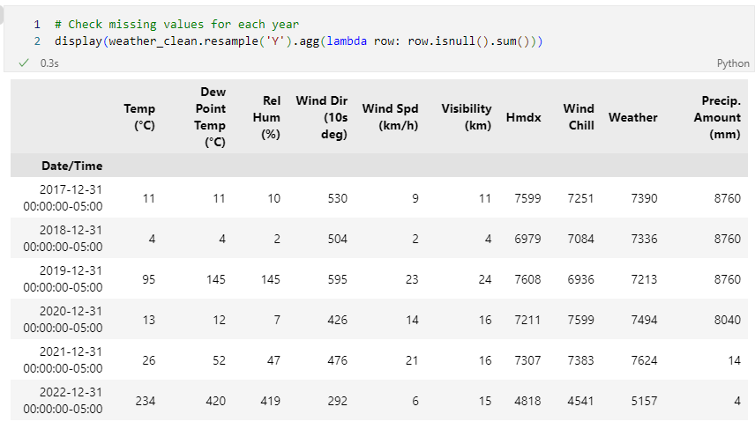
Data Cleaning-Weather Data
Load
Load Weather Data
Clean
Check for missing values
Pre-processing
Drop unwanted columns
Datetime Conversion
Check for outliers
Rename the columns
Check on duplicates

Slide 8
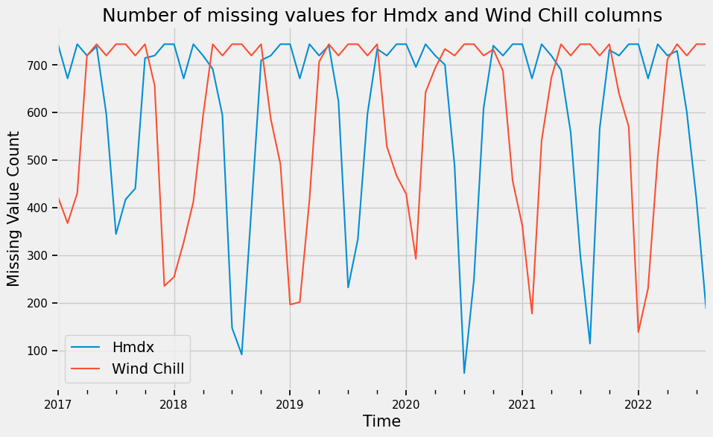
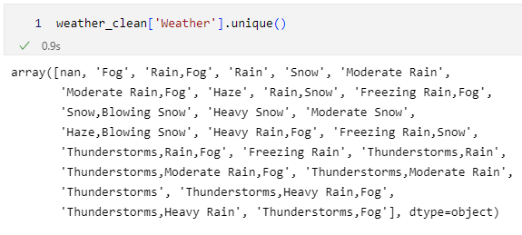
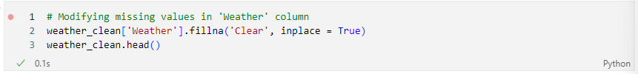
Data Cleaning-Weather Data
Load
Load Weather Data
Clean
Check for missing values
Pre-processing
Drop unwanted columns
Datetime Conversion
Check for outliers
Rename the columns
Check on duplicates
Linear Interpolation for filling NaN of other numerical features.

Slide 9
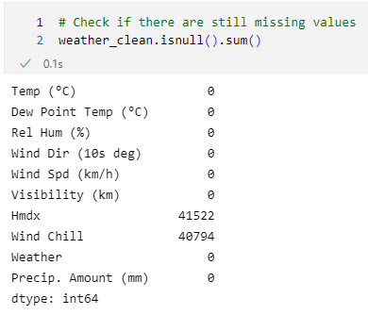
Data Cleaning-Weather Data
Load
Load Weather Data
Clean
Check for missing values
Pre-processing
Drop unwanted columns
Datetime Conversion
Check for outliers
Rename the columns
Check on duplicates
Clean weather data:
“weather_clean”

Slide 10
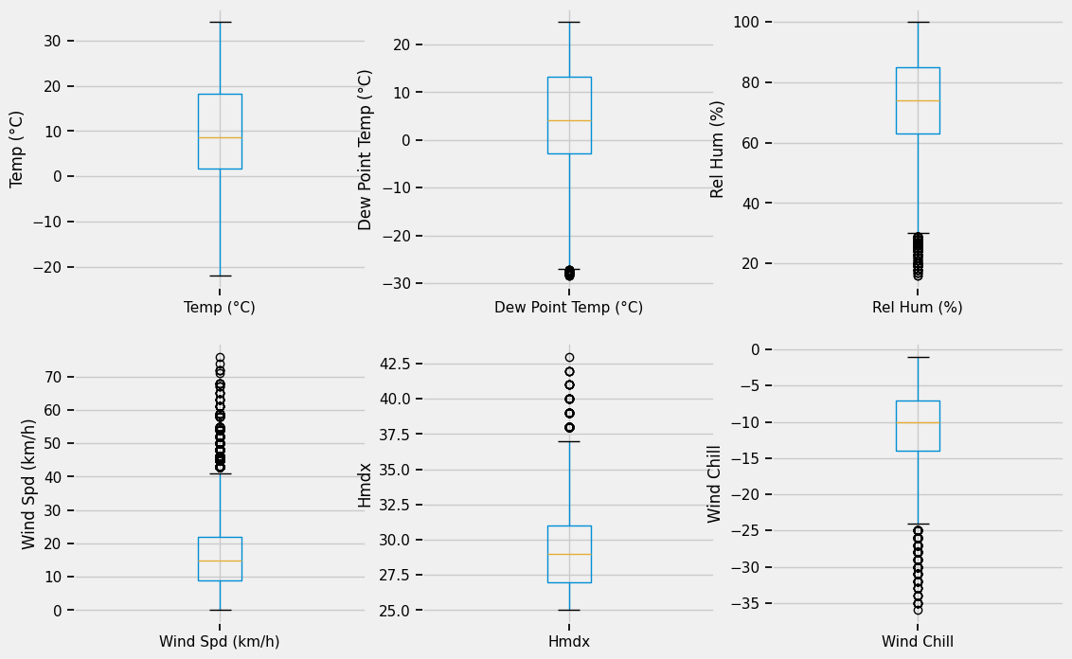
Data Cleaning-Weather Data
Load
Load Weather Data
Clean
Check for missing values
Pre-processing
Drop unwanted columns
Datetime Conversion
Check for outliers
Rename the columns
Check on duplicates

Slide 11
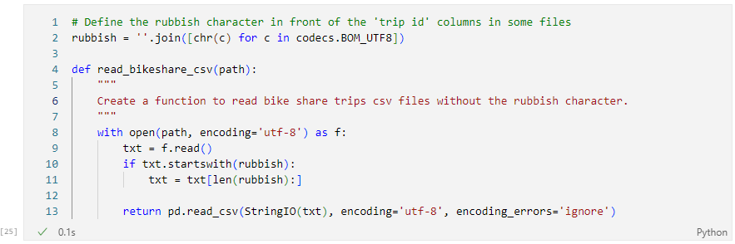
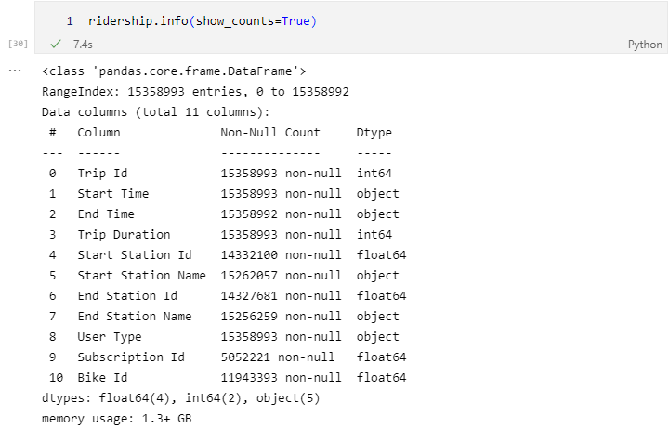
Data Cleaning-Ridership Data
Load
Load Ridership Data
Clean
Missing values and name inconsistency
Merge
Merge weather data with ridership data
Pre-processing
Drop unwanted columns
Output
Write merged dataframe to a csv file
Unify user type formats
Datetime Conversion
Duplicate trips
Outliers
Rename the columns

Slide 12
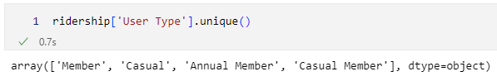
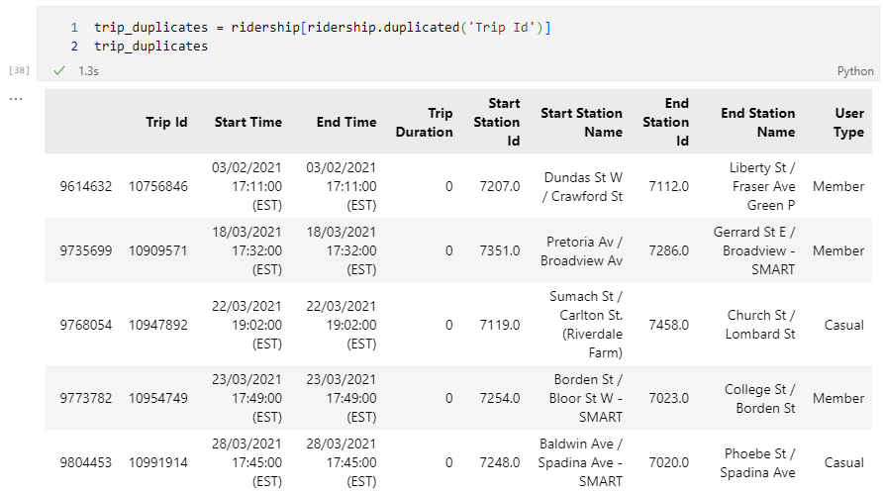
Data Cleaning-Ridership Data
Load
Load Ridership Data
Clean
Missing values and name inconsistency
Merge
Pre-processing
Drop unwanted columns
Output
Write merged dataframe to a csv file
Unify user type formats
Duplicate trips
Outliers
Rename the columns
Datetime Conversion
Merge weather data with ridership data

Slide 13
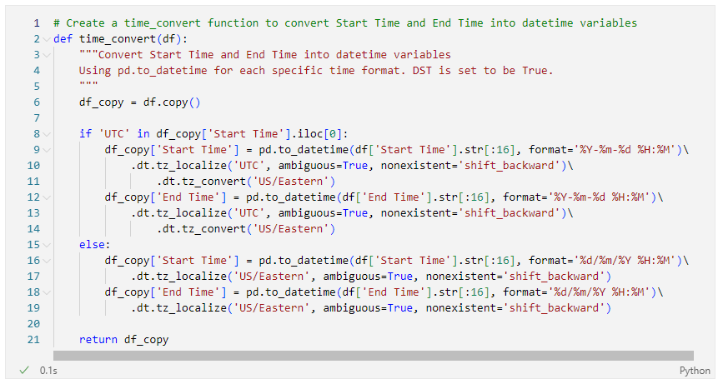
Data Cleaning-Ridership Data
Load
Load Ridership Data
Clean
Missing values and name inconsistency
Merge
Merge weather data with ridership data
Pre-processing
Drop unwanted columns
Output
Write merged dataframe to a csv file
Unify user type formats
Duplicate trips
Outliers
Rename the columns
Datetime Conversion
Split ridership data for different years
e.g.: ridership_2017
Datetime data time_convert

Slide 14
Data Cleaning-Ridership Data
Outliers of Trip Duration
time_convert
Datetime convert
plot_distribution
Fill missing station ID
remove_outliers
Fill missing Station Name
Update station names
Fill missing station ID again
fill_id
fill_name
replace_name
fill_id_merge

Slide 15
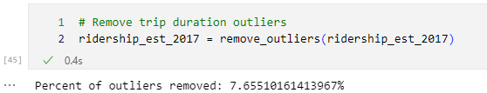
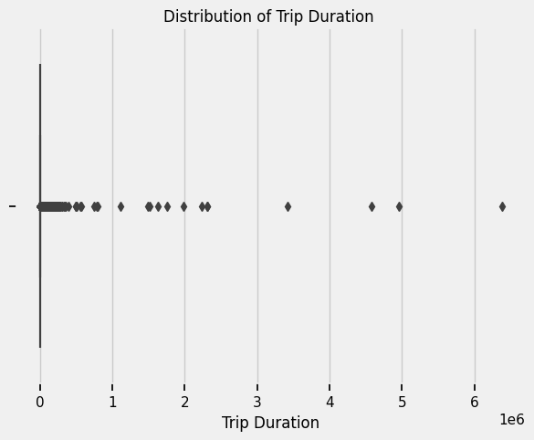
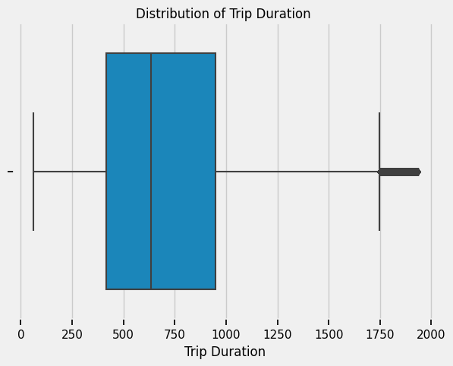
Ridership_est_2017 cleaning

Slide 16
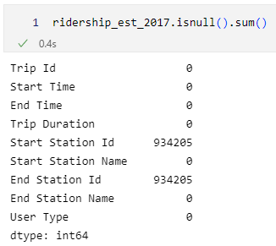
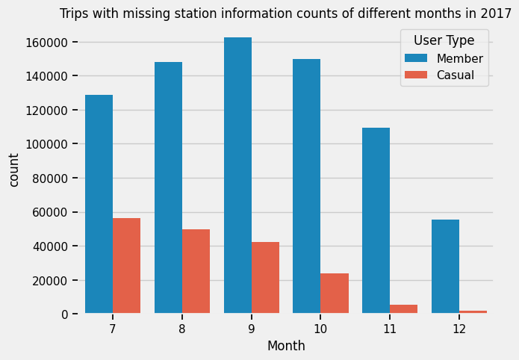
Ridership_est_2017 cleaning

Slide 17
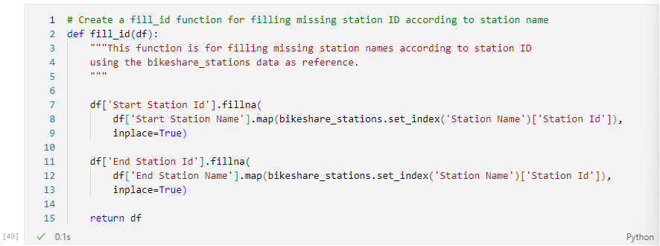
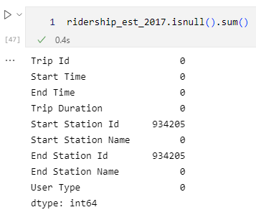
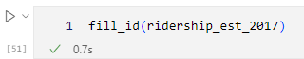
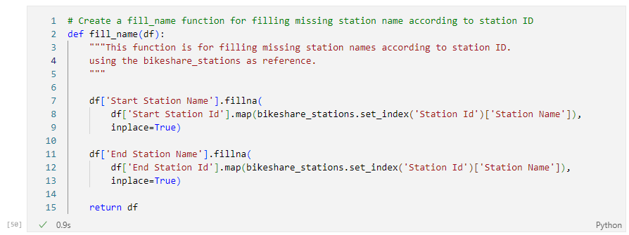
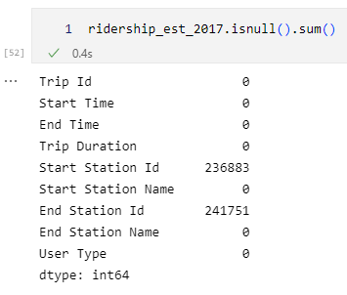
Ridership_est_2017 cleaning

Slide 18
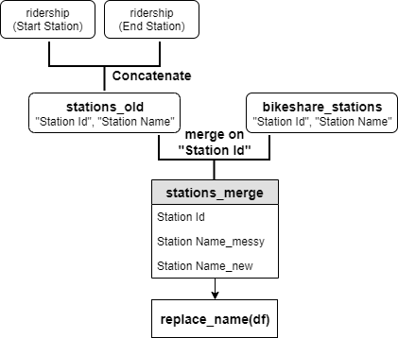
Ridership_est_2017 cleaning
Notes:
fuzzywuzzy

Slide 19
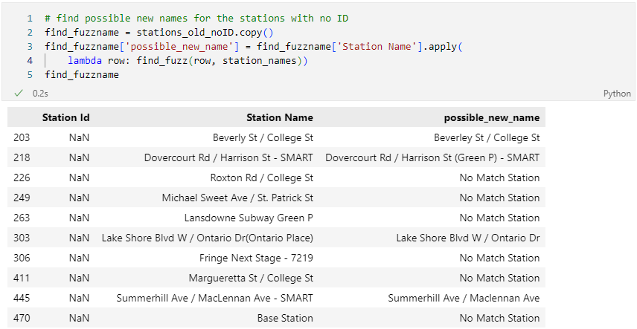
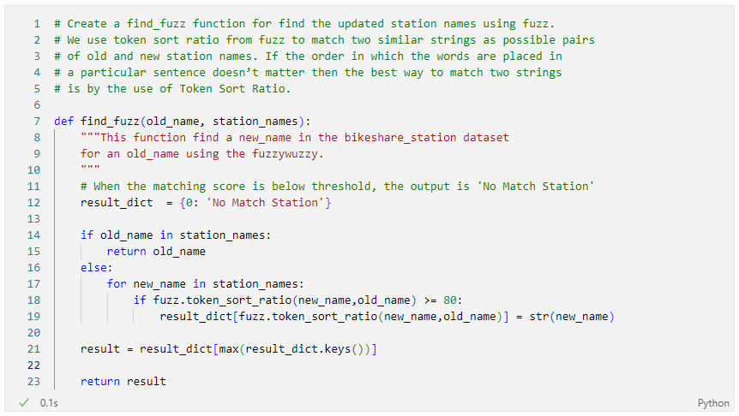
Ridership_est_2017 cleaning

Slide 20
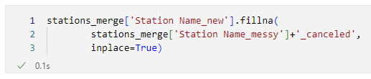
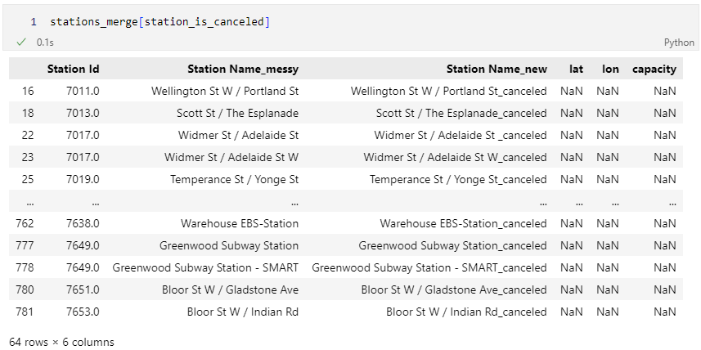
Ridership_est_2017 cleaning
Canceled stations: set new station names with “_canceled”

Slide 21
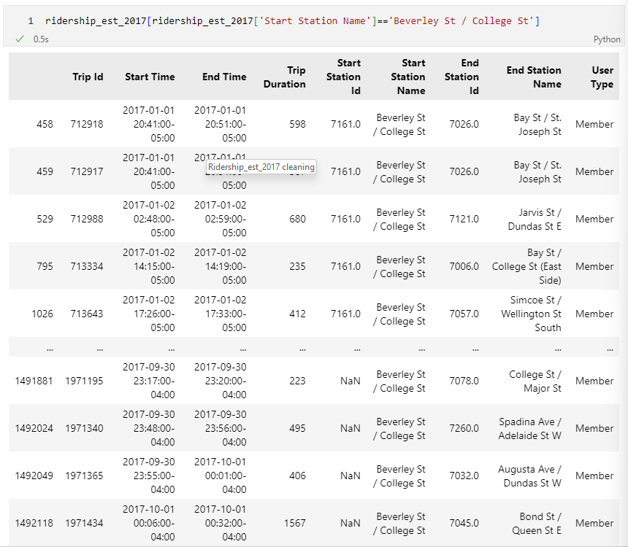
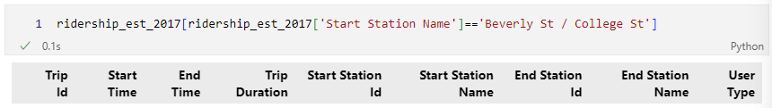
Ridership_est_2017 cleaning

Slide 22
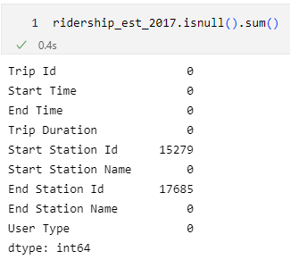
Ridership_est_2017 cleaning
Create another function fill_id_merge to fill missing ID
using the stations_merge df

Slide 23
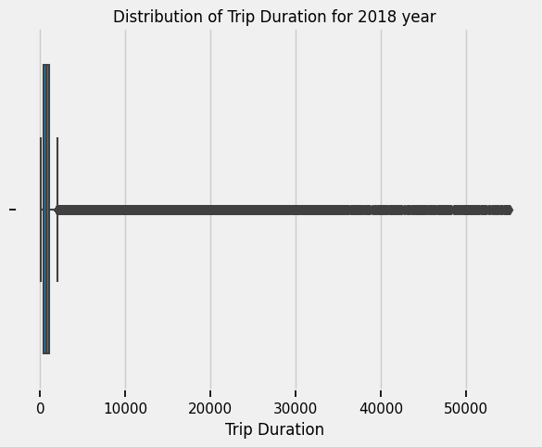
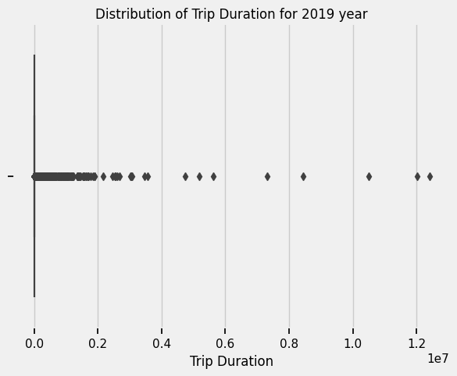
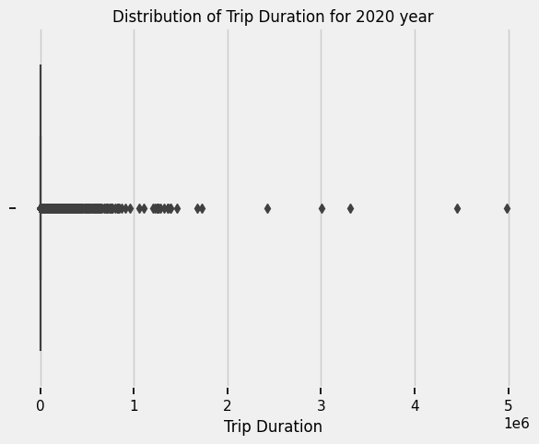
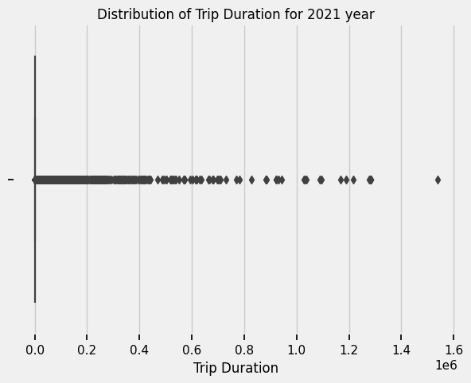
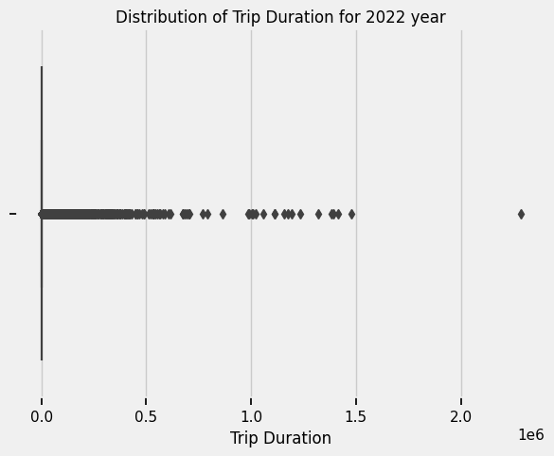
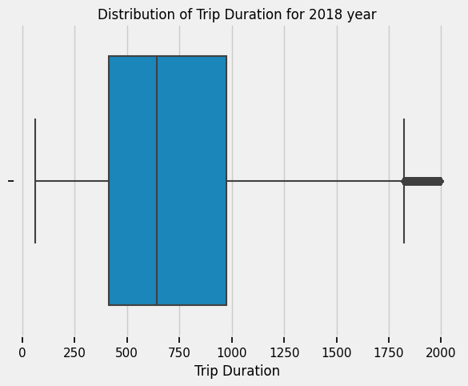
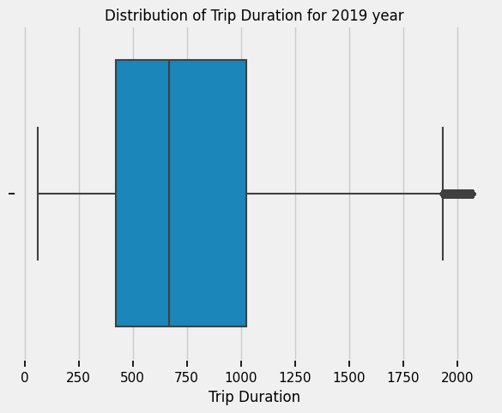

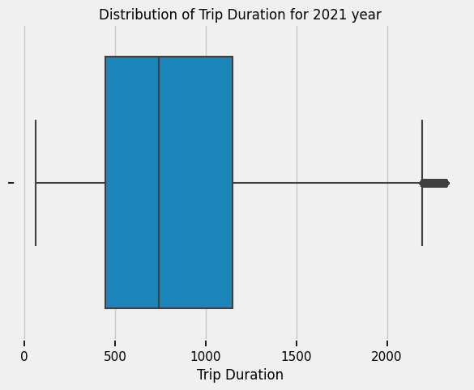

Data cleaning for ridership data 2018 to 2022
Plot_distribution -> remove_outliers
2018 2019 2020 2021 2022

Slide 24
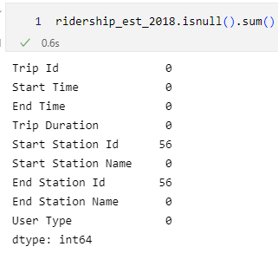
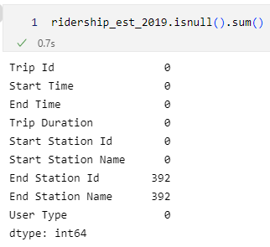
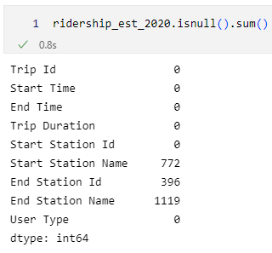
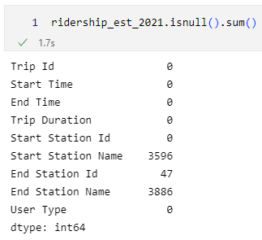
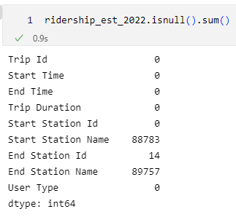
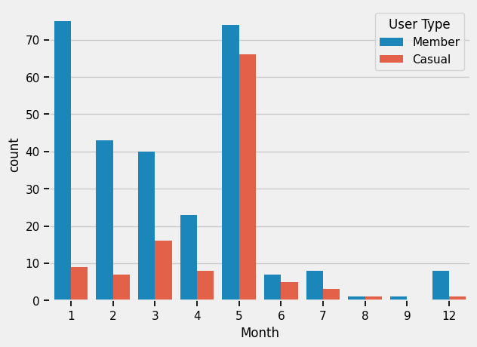
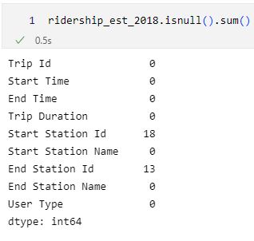
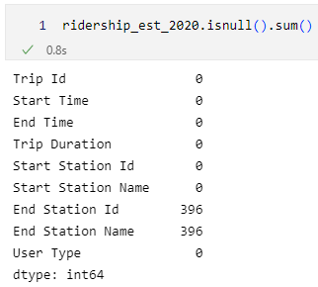
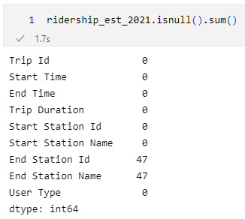
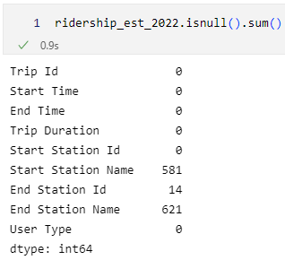
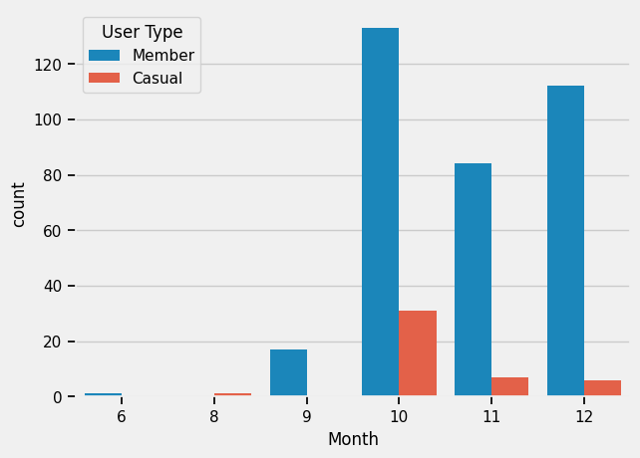


Data cleaning for ridership data 2018 to 2022
(fill_id) -> (fill_name) -> replace_name -> fill_id_merge
Clean ridership data:
“ridership_clean”
2018 2019 2020 2021 2022

Slide 25


Data Cleaning-Ridership Data
Data Cleaning-Ridership Data
Load
Load Ridership Data
Clean
Missing values and name inconsistency
Merge
Merge weather data with ridership data
Pre-processing
Drop unwanted columns
Output
Write merged dataframe to a csv file
Unify user type formats
Datetime Conversion
Duplicate trips
Outliers
Check for feature distribution
Rename the columns
Merged data:
“df_merged”, “df_merged_stations”

Slide 26
Exploratory Data Analysis
Temporal

Slide 27


Temporal EDA :Climate
Features with Positive Correlation in terms of Number of Trips and Trip Duration

Slide 28


Temporal EDA :Climate
Features with Negative Correlation in terms of Number of Trips and Trip Duration

Slide 29


Temporal EDA :Climate
Features with No Correlation in terms of Number of Trips and Trip Duration

Slide 30

Temporal EDA :Workdays Vs Weekend

Slide 31

Temporal EDA :Month in Year

Slide 32

Temporal EDA :Monthly Distribution
The Trips Duration between Casual Members and Annual Members on Monthly Basis

Slide 33

Temporal EDA :Seasonal

Slide 34

Temporal EDA :Seasonal

Slide 35
Top 5 most popular routes
1. Ontario Place Blvd / Lakeshore Blvd W - Ontario Place Blvd / Lakeshore Blvd W
2. Tommy Thompson Park (Leslie Street Spit) - Tommy Thompson Park (Leslie Street Spit)
3. HTO Park (Queens Quay W) - HTO Park (Queens Quay W)
4. Cherry Beach - Tommy Thompson Park (Leslie Street Spit)
5. Bathurst St/Queens Quay(Billy Bishop Airport)- York St / Queens Quay W

Slide 36
The Top 5 most popular route
Summer
Winter
1. Ontario Place Blvd / Lakeshore Blvd W - Ontario Place Blvd / Lakeshore Blvd W
2. Tommy Thompson Park (Leslie Street Spit) - Tommy Thompson Park (Leslie Street Spit)
3. HTO Park (Queens Quay W) - HTO Park (Queens Quay W)
4. Cherry Beach - Tommy Thompson Park (Leslie Street Spit)
5. Humber Bay Shores Park West - Humber Bay Shores Park West
1. Front St W / Blue Jays Way - Union Station
2. Bathurst St/Queens Quay(Billy Bishop Airport) - York St / Queens Quay W
3. York St / Queens Quay W - Bathurst St/Queens Quay(Billy Bishop Airport)
4. Cariboo St / Rail Path - Bloor GO / UP Station/ Rail Path_canceled
5. St. George St / Bloor St W - St. George St / Russell St - SMART

Slide 37
The Top 5 most popular route
Fall
Spring
1. Ontario Place Blvd / Lakeshore Blvd W - Ontario Place Blvd / Lakeshore Blvd W
2. Tommy Thompson Park (Leslie Street Spit) - Tommy Thompson Park (Leslie Street Spit)
3. Front St W / Blue Jays Way - Union Station
4. Bathurst St/Queens Quay(Billy Bishop Airport) - York St / Queens Quay W
5. York St / Queens Quay W – Bathurst St/Queens Quay(Billy Bishop Airport)
1. Tommy Thompson Park (Leslie Street Spit) - Tommy Thompson Park (Leslie Street Spit)
2. Ontario Place Blvd / Lakeshore Blvd W - Ontario Place Blvd / Lakeshore Blvd W
3. Cherry Beach - Tommy Thompson Park (Leslie Street Spit)
4. Humber Bay Shores Park West - Humber Bay Shores Park West
5. HTO Park (Queens Quay W) - HTO Park (Queens Quay W)

Slide 38
The Top 5 most popular route
Annual Members
Winter
1. Front St W / Blue Jays Way - Union Station
2. Bathurst St/Queens Quay(Billy Bishop Airport) - York St / Queens Quay W
3. York St / Queens Quay W - Bathurst St/Queens Quay(Billy Bishop Airport)
4. Tommy Thompson Park (Leslie Street Spit) - Tommy Thompson Park (Leslie Street Spit)
5. Wellesley St E / Yonge St Green P_canceled - Sherbourne St / Wellesley St E
1. Front St W / Blue Jays Way - Union Station
2. Bathurst St/Queens Quay(Billy Bishop Airport) - York St / Queens Quay W
3. York St / Queens Quay W - Bathurst St/Queens Quay(Billy Bishop Airport)
4. Cariboo St / Rail Path - Bloor GO / UP Station/ Rail Path_canceled
5. St. George St / Bloor St W - St. George St / Russell St - SMART

Slide 39
The Top 5 most popular route
Casual Members
Summer
1. Ontario Place Blvd / Lakeshore Blvd W - Ontario Place Blvd / Lakeshore Blvd W
2. Tommy Thompson Park (Leslie Street Spit) - Tommy Thompson Park (Leslie Street Spit)
3. HTO Park (Queens Quay W) - HTO Park (Queens Quay W)
4. Humber Bay Shores Park West - Humber Bay Shores Park West
5. Lakeshore Blvd W / Ontario Dr - Lakeshore Blvd W / Ontario Dr
1. Ontario Place Blvd / Lakeshore Blvd W - Ontario Place Blvd / Lakeshore Blvd W
2. Tommy Thompson Park (Leslie Street Spit) - Tommy Thompson Park (Leslie Street Spit)
3. HTO Park (Queens Quay W) - HTO Park (Queens Quay W)
4. Cherry Beach - Tommy Thompson Park (Leslie Street Spit)
5. Humber Bay Shores Park West - Humber Bay Shores Park West

Slide 40

Temporal EDA: Annual

Slide 41

Temporal EDA: Annual

Slide 42
Top 5 Busiest Start Stations
Before Pandemic
During Pandemic
1. Union Station
2. Bay St / Wellesley St W
3. York St / Queens Quay W
4. Simcoe St / Wellington St South
5. Dundas St W / Yonge St
1. York St / Queens Quay W
2. Lake Shore Blvd W / Ontario Dr
3. Queens Quay E / Lower Sherbourne St
4. Bay St / Queens Quay W (Ferry Terminal)
5. Ontario Place Blvd / Lake Shore Blvd W (East)

Slide 43

Geospatial EDA :Conclusion
Summer
Spring
Monthly/Yearly
Fall
Spring
Summer
When?
Casual/Daily

Slide 44
Exploratory Data Analysis
Geospatial

Slide 45




Exploratory Data Analysis
Neighbourhoods
Stations
Which ones has most and longest rides?
Top 10 stations with rides for diff users
Subway Stations
Bike Lanes
Identify the subway stations close to the top bike stations
For future work ! We want to explore the congested lanes

Slide 46

Geospatial EDA :Neighbourhoods
Data Cleaning-Ridership Data
How many rides start/end?

Slide 47

Geospatial EDA :Neighbourhoods
Data Cleaning-Ridership Data
What is the average trip duration?

Slide 48

Geospatial EDA :Neighbourhoods
Data Cleaning-Ridership Data
How many rides increased from 2017 to 2021?

Slide 49

Geospatial EDA :Neighbourhoods
Data Cleaning-Ridership Data
But, how much did rides increase when normalized?

Slide 50

Geospatial EDA :Neighbourhoods
What happened to ride numbers due to the Pandemic?

Slide 51

Geospatial EDA :Neighbourhoods
Data Cleaning-Ridership Data
What happened to ride numbers due the Pandemic, normalized?

Slide 52

Geospatial EDA :Stations
Data Cleaning-Ridership Data
What are the top 10 start stations? Members Vs Casual

Slide 53

Geospatial EDA :Stations
Data Cleaning-Ridership Data
Let’s visualize the top 10 stations on the map !
Members
Casual
Downtown
Lakeshore

Slide 54

Geospatial EDA :Subway stations
Data Cleaning-Ridership Data
Which Subway Stations are closely related to bike rides?
Line 1 –
Union Station

Slide 55
Geospatial EDA :Conclusion
Downtown Toronto
Lakeshore
Monthly/Yearly
Scarborough
Etobicoke
North York
Downtown Toronto
Front St
Bathurst
Queens Quay
Lake Shore BLVD
HTO Park
Lower Simcoe
Bay
Yonge
College
Wellesley
Dundas
Union station
Queen Station
Wellesley Station
College station
University Avenue
Osgoode Station
Where?
Casual/Daily

Slide 56
EDA :Conclusion
Neigh-borhood
Tempe-rature
What Features to use in the Model ?
Routes
Visibility
Wind Chill
Week of Day
Season
User Type

Slide 57
Model

Slide 58

INITIAL FEATURES
We will be using the bikeshare data from 2018 to create a model
The initial features have a weak correlation to the target variable(Trip Duration).
We will have to engineer features that have a stronger correlation to the target variable to create a good model.

Slide 59


Data Analysis For Feature Engineering
Due to the original features not having a strong correlation with trip duration. We need to analyze the data to Engineer features that are better correlated
The Graphs to the right show the mean trip for each unique value of windchill and humidex
Although there isn’t great variability, we can still categorically encode these variables.

Slide 60


Data Analysis For Feature Engineering
The mean trip duration for Neighborhoods and Weather show much greater variability.
Categorically Encoding these variables may help the model.
Additionally, one feature to add that would logically be correlated to trip duration is distance.

Slide 61

Data Analysis For Feature Engineering
There is a significant difference in mean trip duration between different types of users
Thus, it would also be helpful to numerically encode the user type
One thing that would also be helpful would be to categorize the different combinations of start and end stations

Slide 62

Data Analysis For Feature Engineering
Looking at the distribution for one possible combination of start and end stations, we can see that a large portion of trips for this combination take between 750-1000 seconds
Therefore, it may be helpful to categorize the different trip combinations
We will group trip combinations by increments of 100 seconds with respect to their mean trip duration

Slide 63

Feature Engineering
A pipeline will be created to add the categorical features to the dataframe.
Due to the latitude and longitude of the start and end stations, we can also define a haversine function to calculate the distance between stations as a feature.

Slide 64

Feature Correlation to Trip Duration
We can see that the new features have a strong correlation to our target variable.
In particular, Trip Combination, Distance and the User Type Category have the strongest correlations. Their correlation coefficients are; 0.802, 0.444, and -0.356 respectively.

Slide 65
Machine Learning Models
We will try three types of model to predict trip duration.
Random Forest, Linear Regression, and Light Gradient Boosting.
To optimize the hyperparameters, we will use BayesSearchCV. As it is not as computationally extensive as GridSearchCV.
We will train the data on the first 6 months of 2018, and test on the last 6 months.

Slide 66

Light Gradient Boosting Model
The Light Gradient Boosting Model has its hyperparameters optimized with BayesSearchCV.

Slide 67

Linear Regression Model
The Linear Regression model and its hyperparameter optimization.

Slide 68

Random Forest Model
The Random Forest model and its hyperparameter optimization.

Slide 69

Results of the Models
The metrics that will be used to measure the success of each model will be the R-Squared Score, The Root Mean Square Error, and the Mean Absolute Error
The Light Gradient Boosting model has the best scores for every metric.
Thus, we will use the Light Gradient Boosting Model to predict the trip duration for future years.

Slide 70
Light GRADIENT BOOSTING EXPLAINED
LGB is a gradient boosting framework based on decision trees that has an increased efficiency which also reduces memory usage.
The Efficiency is increased due to Exclusive Feature Bundling, which identifies mutually exclusive features and merges them.
LGB also uses gradient based one side sampling, which essentially resamples instances with small error, but retains ones with moderate-high training error.

Slide 71
Limitations of the dataset
The initial features are not great predictors of the target variable. Making feature engineering more difficult.
If we were provided features such as; age, trip purpose, user ID, the model would be a lot more accurate.

